Slide 1

History of Cloud Computing
Dr. Saroja Kumar Rout
Associate Professor, Depatment of IT

Slide 2
Cloud Computing
Cloud Computing referred as the accessing and storing of data and provide services related to computing over the internet.
It simply referred as it remote services on the internet manage and access data online rather than any local drives.
The data can be anything like images, videos, audios, documents, files etc.

Slide 3
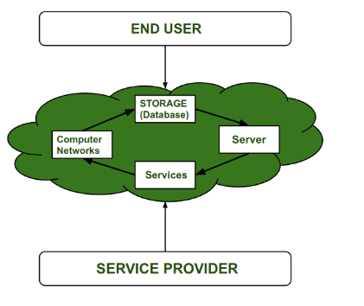

Slide 4
Cloud Computing Service Provider’s :
Cloud computing is in huge demand so, big organization providing the service like Amazon AWS, Microsoft Azure, Google Cloud, Alibaba cloud etc. are some Cloud Computing service Provider.

Slide 5
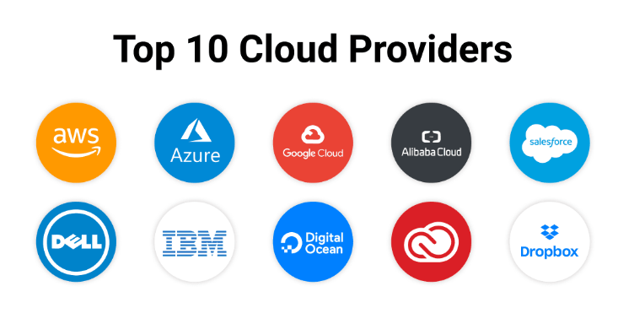

Slide 6
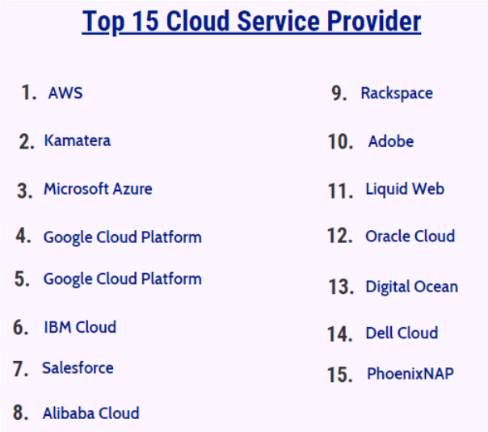

Slide 7
History of Cloud Computing :
Before Computing was come into existence, client Server Architecture was used where all the data and control of client resides in Server side.
If a single user want to access some data, firstly user need to connect to the server and after that user will get appropriate access.
But it has many disadvantages. So, After Client Server computing,
Distributed Computing was come into existence, in this type of computing all computers are networked together with the help of this, user can share their resources when needed.
It also has certain limitations. So in order to remove limitations faced in distributed system, cloud computing was emerged.

Slide 8
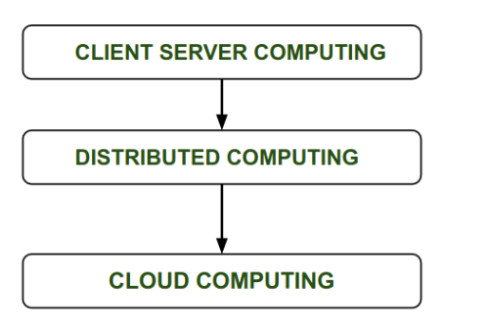

Slide 9
At around in 1961, John MacCharty suggested in a speech at MIT that computing can be sold like a utility, just like a water or electricity.
It was a brilliant idea, but like all brilliant ideas, it was ahead if its time, as for the next few decades, despite interest in the model, the technology simply was not ready for it.

Slide 10
In 1999, Salesforce.com started delivering of applications to users using a simple website. The applications were delivered to enterprises over the Internet, and this way the dream of computing sold as utility were true.
In 2002, Amazon started Amazon Web Services, providing services like storage, computation and even human intelligence. However, only starting with the launch of the Elastic Compute Cloud in 2006 a truly commercial service open to everybody existed.
In 2009, Google Apps also started to provide cloud computing enterprise applications.
In 2009, Microsoft launched Windows Azure, and companies like Oracle and HP have all joined the game. This proves that today, cloud computing has become mainstream.

Slide 11
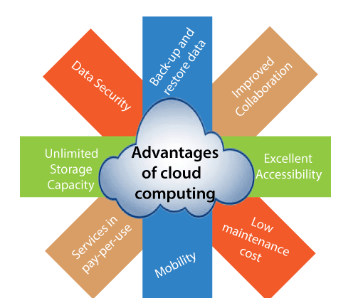
Advantages of Cloud Computing

Slide 12
Advantages :
1) Back-up and restore data
Once the data is stored in the cloud, it is easier to get back-up and restore that data using the cloud.
2) Improved collaboration
Cloud applications improve collaboration by allowing groups of people to quickly and easily share information in the cloud via shared storage.
3) Excellent accessibility
Cloud allows us to quickly and easily access store information anywhere, anytime in the whole world, using an internet connection. An internet cloud infrastructure increases organization productivity and efficiency by ensuring that our data is always accessible.
4) Low maintenance cost
Cloud computing reduces both hardware and software maintenance costs for organizations.
5) Mobility
Cloud computing allows us to easily access all cloud data via mobile.
6) IServices in the pay-per-use model
Cloud computing offers Application Programming Interfaces (APIs) to the users for access services on the cloud and pays the charges as per the usage of service.
7) Unlimited storage capacity
Cloud offers us a huge amount of storing capacity for storing our important data such as documents, images, audio, video, etc. in one place.
8) Data security
Data security is one of the biggest advantages of cloud computing. Cloud offers many advanced features related to security and ensures that data is securely stored and handled.

Slide 13
Disadvantages of Cloud Computing
A list of the disadvantage of cloud computing is given below -
1) Internet Connectivity
As you know, in cloud computing, every data (image, audio, video, etc.) is stored on the cloud, and we access these data through the cloud by using the internet connection. If you do not have good internet connectivity, you cannot access these data. However, we have no any other way to access data from the cloud.
2) Vendor lock-in
Vendor lock-in is the biggest disadvantage of cloud computing. Organizations may face problems when transferring their services from one vendor to another. As different vendors provide different platforms, that can cause difficulty moving from one cloud to another.
3) Limited Control
As we know, cloud infrastructure is completely owned, managed, and monitored by the service provider, so the cloud users have less control over the function and execution of services within a cloud infrastructure.
4) Security

Slide 14


Slide 15


